Slide 1
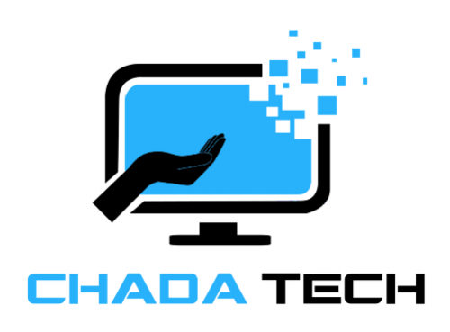
Agile Methodology Presentation
Thomas Comer
4/18/2025
Chada Tech
LOGO HERE

Slide 2

What is Agile?
Agile is a product development methodology that breaks projects down into several phases, known as sprints, in order to maximize development efficiency. (Laoyan, S. 2025) It involves multiple team members with different roles all working together to achieve the same outcome. These roles are the Product Owner, the Scrum Master, the Tester, and the Developer.

Slide 3

Product Owner
The role most responsible for overseeing the projects outcome. (Hoffman, D. 2024)
The voice of the client, speaks directly to the client to know everything they need.
Creates user stories and backlogs to ensure the rest of the team knows what must be produced for the client.

Slide 4

Scrum Master
The Scrum Master facilitates the scrum process and holds time-boxed iterative development periods called sprints. (Rehkopf, M. 2025)
Holds daily scrum meetings, as well as sprint planning, review and retrospective meetings before and after each sprint.
Administrates the Organizational Tools such as Microsoft Azure Boards.
Ensures communication is constantly ongoing throughout the team.

Slide 5

Tester
Creates test cases to ensure the product meets a specific expectation of quality.
Constantly works on testing, testing code as it is written, hand in hand with the developer.
Gives feedback to the developer and suggests changes when necessary.

Slide 6

Developer
Creates software applicable to the client’s expectations and meets a standard of quality to ensure the client is satisfied with the product. (Cobb, C. 2021)
Works together with the rest of the team to ensure the clients requirements and specifications are met.
Works in an iterative process that allows them to make changes whenever necessary.

Slide 7

Waterfall Methodology
Waterfall Methodology is commonly thought of as the traditional method of development. It involves a linear and sequential approach to project management that requires each phase of development to be completed in its entirety before moving onto the next. This means that it requires a lot of upfront planning as the entire phase of development must be known in advance for each phase.

Slide 8
Waterfall Vs. Agile
Agile Pros:
Agile Cons:
Flexible and adaptable, with being able to make changes at any time, with iterative and continuous development.
Harder to predict, and more resource intensive. More prone to scope creep.
Waterfall Pros:
Waterfall Cons
Much more predictable timelines, and the scope of requirements is known from the start.
Far less flexibility, and it becomes difficult to work on work from previous development phases.

Slide 9
References
Laoyan, S. (2025, February 20). What is agile methodology? (a beginner’s guide) [2025] • asana. Asana. https://asana.com/resources/agile-methodology
Hoffman, D. (2024, October 22). What is a product owner?: Definition from TechTarget. Search Software Quality. https://www.techtarget.com/searchsoftwarequality/definition/product-owner#:~:text=A%20product%20owner%20is%20a,to%20communicate%20and%20self%2Dorganize.
Rehkopf, M. (2025). What is a scrum master? roles & responsibilities. Atlassian. https://www.atlassian.com/agile/scrum/scrum-master
Cobb, C. (2021, January 5). Agile Project Management training. Agile Project Management. https://managedagile.com/what-does-it-mean-to-be-an-agile-developer/

